Slide 1
Cloud Migration Workshop
Clifford Duke Solutions Architect 2019-10-29
© 2019, Amazon Web Services, Inc. or its Affiliates.

Slide 2


Migrations overview
© 2019, Amazon Web Services, Inc. or its Affiliates. All rights reserved. Amazon Confidential and Trademark
© 2019, Amazon Web Services, Inc. or its Affiliates. All rights reserved. Amazon Confidential and Trademark

Slide 3





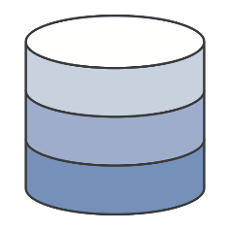


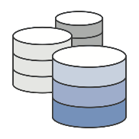





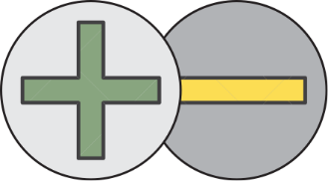
Common migration drivers
Agility/Dev Productivity
Data Center
Consolidation
Innovation &
Digital Transformation
Cost Reduction
Acquisitions
or Divestitures
Large scale compute intensive workloads (HPC & Big Data)
Facility or Real-estate decisions
Colocation or
outsourcing contract changes
© 2019, Amazon Web Services, Inc. or its Affiliates. All rights reserved. Amazon Confidential and Trademark

Slide 4






Potential barriers to cloud adoption
Possible challenges to migrating quickly and cost-effectively
Existing investments
Upfront expenses
Skeptical stakeholders
Application interdependencies
Concerns of downtime during migration
Lack of cloud expertise
© 2019, Amazon Web Services, Inc. or its Affiliates. All rights reserved. Amazon Confidential and Trademark

Slide 5


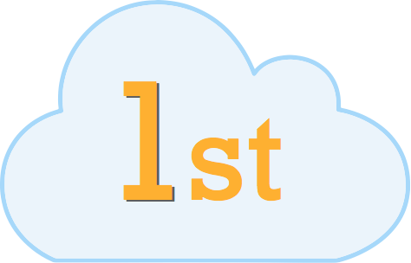


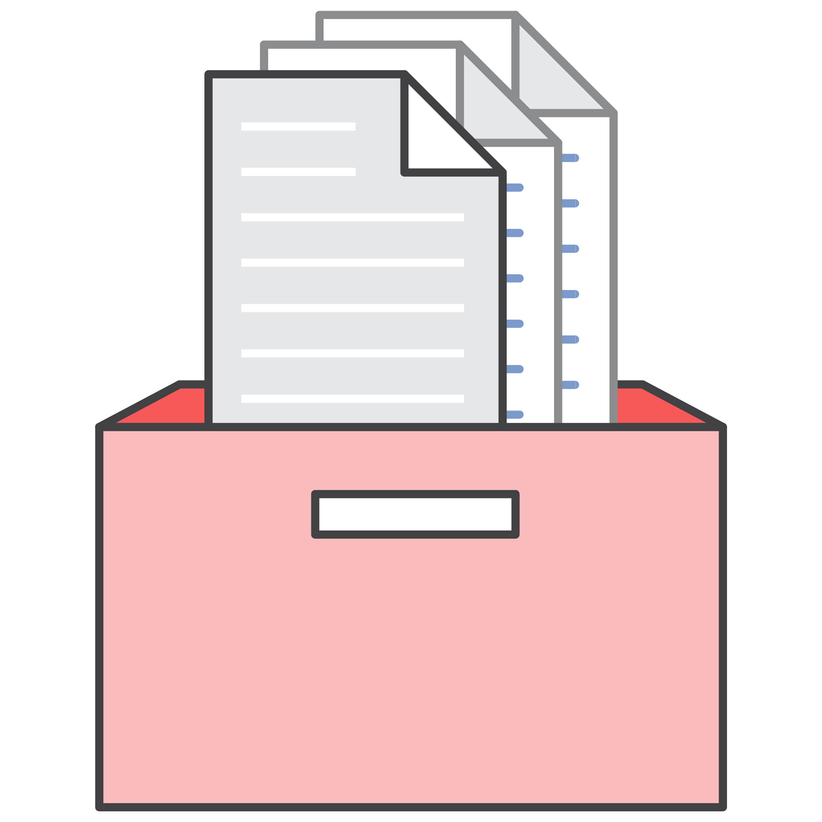




Elements of a Successful Journey
Executive Sponsorship
Align on business requirements; bring all stakeholders with you
Cloud-First Strategy
Create your vision; incentivize team members to follow your lead
Organizational Change
Define new operating models, policies, processes, economics; provide training
Adoption Roadmap
Start small and iterate, measure, manage and update plan
Cloud Center of Excellence
Provide centralized expertise; guide decentralized innovations
Principles & Standards
Publish guidance and guard rails for how to adopt cloud successfully
Experiment
Define Architectures, patterns, governance; measure, monitor, iterate
© 2019, Amazon Web Services, Inc. or its Affiliates. All rights reserved. Amazon Confidential and Trademark

Slide 6
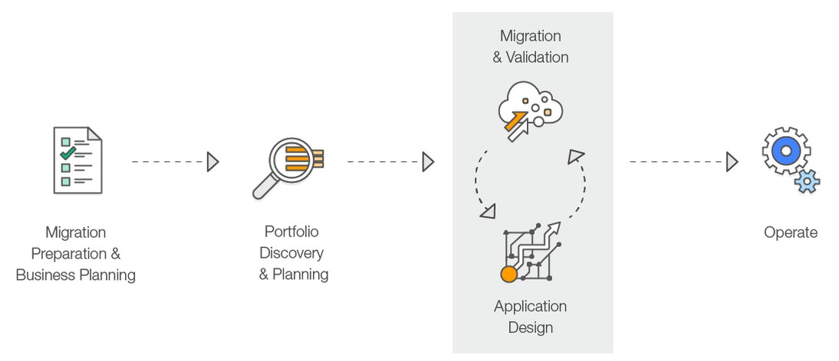
The Migration Process
© 2019, Amazon Web Services, Inc. or its Affiliates. All rights reserved. Amazon Confidential and Trademark

Slide 7
How - Migration planning
Discover and organize data
7 Rs
Re-architect Re-platform
Re-purchase Re-host Relocate Retain Retire
Example
To Serverless
To Managed service To SaaS
To EC2 To VMC
Applications
Level of effort
Infrastructure
Performance
© 2019, Amazon Web Services, Inc. or its Affiliates. All rights reserved. Amazon Confidential and Trademark

Slide 8





Modernization
Current state
Future state
Rehost, Re-platform,
Re-architect
Monolithic application
Microservices application
© 2019, Amazon Web Services, Inc. or its Affiliates. All rights reserved. Amazon Confidential and Trademark

Slide 9




© 2018, Amazon Web Services, Inc. or its Affiliates. All rights reserved. Amazon Confidential and Trademark
© 2019, Amazon Web Services, Inc. or its Affiliates. All rights reserved. Amazon Confidential and Trademark

Slide 10



Re-host
Pros:
Usually the fastest migration strategy
No architectural modifications
Cons:
Miss most “cloudy” benefits of target platform—both
technical and financial
Virtual machines
Right size on AWS VMs
© 2019, Amazon Web Services, Inc. or its affiliates. All rights reserved.

Slide 11












On-premise / Colocation
DC1
LB LB
Web Web
App App
DB DB
NFS/SMB NFS/SMB
© 2019, Amazon Web Services, Inc. or its affiliates. All rights reserved.

Slide 12














AWS Cloud
 | Availability Zone 1
 | VPC LB LB Web Web App App DB DB NFS/SMB NFS/SMB
Capabilities
Choice of processor*
(AWS, Intel, AMD)
Fast processors
(up to 4.0 GHz)
High memory footprint
(up to 24 TiB)
Instance storage
(HDD and NVMe)
Accelerated computing
(GPUs and FPGA)
175
instance types
for virtually every workload
and business need
Networking
(up to 100 Gbps)
Bare Metal Size
(Nano to 32xlarge)
NE W !
© 2019, Amazon Web Services, Inc. or its affiliates. All rights reserved.

Slide 13
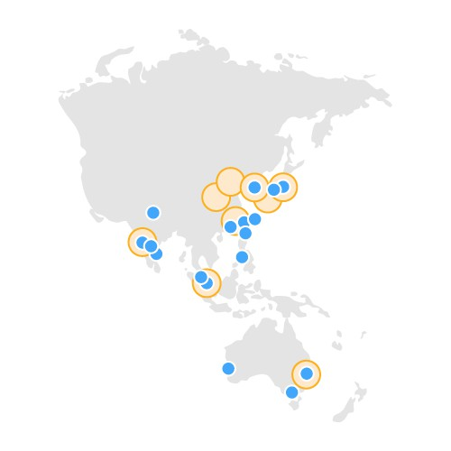



AWS Region
AWS Cloud
 | Availability Zone 1
 | VPC LB LB Web Web App App DB DB NFS/SMB NFS/SMB
AWS Availability Zone (AZ)
Transit
AZ
Datacenter
Datacenter
AZ
Datacenter
Transit
AZ
A Region is a physical location in the world where we have multiple Availability Zones.
Availability Zones consist of one or more discrete data centers, each with redundant power, networking, and connectivity, housed in separate facilities.
© 2019, Amazon Web Services, Inc. or its affiliates. All rights reserved.

Slide 14













AWS Cloud
Availability Zone 1
Availability Zone 2
VPC
LB
LB
Web
Web
App
App
DB
DB
NFS/SMB
NFS/SMB
© 2019, Amazon Web Services, Inc. or its affiliates. All rights reserved.

Slide 15

© 2018, Amazon Web Services, Inc. or its Affiliates. All rights reserved. Amazon Confidential and Trademark
© 2019, Amazon Web Services, Inc. or its Affiliates. All rights reserved. Amazon Confidential and Trademark

Slide 16





Re-platform options
Pros:
Realize some benefits of cloud platform
Minimal architectural modifications
Cons:
Can be some rework required
Managed virtual machines
Containers
……
Managed Database
Managed File server
© 2019, Amazon Web Services, Inc. or its affiliates. All rights reserved.

Slide 17
AWS Cloud
 | Availability Zone 1 |  | Availability Zone 2
 | VPC LB Web App DB File |  | LB Web App DB File
© 2019, Amazon Web Services, Inc. or its affiliates. All rights reserved.

Slide 18

AWS Cloud
Availability Zone 1 VPC
Availability Zone 2
ALB/NLB
Application Load Balancer
Network Load Balancer
ALB NLB
Load balancer
high availability, automatic scaling, and robust security
Web
Web
App
App
DB
DB
File
File
© 2019, Amazon Web Services, Inc. or its affiliates. All rights reserved.

Slide 19


Elastic Beanstalk
AWS Cloud
Availability Zone 1
Availability Zone 2
VPC
ALB NLB
Provided by you
Load balancer
Provided and managed by Elastic Beanstalk
Elastic Beanstalk
Runtime: Java, .NET, PHP, Node.js, Python, Ruby, Go, and Docker
Web
Web
Applications Deployment
Your code
HTTP server
App
App
Application server
Language
DB
DB
interpreter
Operating system
File
File
Host
© 2019, Amazon Web Services, Inc. or its affiliates. All rights reserved.

Slide 20



AWS Cloud
Availability Zone 1 VPC
RDS
Managed by you
Availability Zone 2
ALB NLB
Load balancer
Managed by AWS
Elastic Beanstalk
EC2
App optimization Scaling
High availability Database backups DB s/w patching DB s/w install
OS patching OS installation
Server maintenance
Hardware lifecycle Power/HVAC/Network
RDS
App optimization Scaling
High availability Database backups DB s/w patching DB s/w install
OS patching OS installation
Server maintenance
Hardware lifecycle Power/HVAC/Network
Web
Web
Applications Deployment
App
App
You manage
AWS manages
RDS
Multi-AZ
Managed Database
DB
DB
File
File
MAZ RPO = 0, RTO = 60-90 sec
Scale, patches with 60-90 sec downtime
Performance, single node mysql 5.6 16x 25k Write, 300k Read
© 2019, Amazon Web Services, Inc. or its affiliates. All rights reserved.

Slide 21





AWS Cloud
Availability Zone 1 VPC
Availability Zone 2
EFS/FSX
ALB NLB
Load balancer
Amazon FSx for Windows File Server
Elastic Beanstalk
Web
Web
Applications Deployment
App
App
RDS
Multi-AZ
Managed Database
DB
DB
Amazon EFS Linux/NFS File Storage
EFS – NFS FSx - SMB
File
File
© 2019, Amazon Web Services, Inc. or its affiliates. All rights reserved.

Slide 22
Managed
AWS Cloud
Availability Zone 1
Availability Zone 2
VPC
ALB NLB
Load balancer
Load balancer
Elastic Beanstalk
Web
Web
Applications Management
Applications Deployment
App
App
RDS
Multi-AZ
Managed Database
Database
DB
DB
EFS – NFS FSx - SMB
NFS/SMB
File
File
© 2019, Amazon Web Services, Inc. or its affiliates. All rights reserved.

Slide 23














Re-platform options
Less
On-Premises
Cloud
Compute
Server, VM Container, K8S
MySQL, PostgreSQL SQL Server, Oracle, MongoDB
AWS Elastic Beanstalk Fargate
EKS
Databases
Amazon RDS
Aurora
DocumentDB
Storage
NFS, SMB
FSx
EFS
Messaging
ActiveMQ Kafka, ESB
Amazon MQ
MSK
Analytics
Hadoop
EMR
Amazon Elasticsearch Service
Elasticsearch Service
© 2019, Amazon Web Services, Inc. or its affiliates. All rights reserved.

Slide 24



© 2019, Amazon Web Services, Inc. or its Affiliates. All rights reserved. Amazon Confidential and Trademark

Slide 25
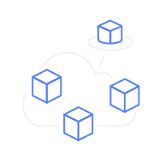
Re-architect options
Pros:
Realize full potential of target cloud
platform
Cons:
Requires the largest
investment and level of effort to realize
Containers
Serverless
© 2019, Amazon Web Services, Inc. or its affiliates. All rights reserved.

Slide 26


Modernize Compute and Operation
© 2019, Amazon Web Services, Inc. or its affiliates. All rights reserved.

Slide 27




AWS Cloud
Availability Zone 1 VPC
AWS Cloud
Lambda
DynamoDB
S3
Availability Zone 2
ALB NLB
Load balancer
Elastic Beanstalk
Web
Web
Applications Deployment
App
App
RDS
Multi-AZ
Managed Database
DB
DB
EFS – NFS FSx - SMB
File
File
© 2019, Amazon Web Services, Inc. or its affiliates. All rights reserved.

Slide 28



AWS Cloud
Availability Zone 1
Availability Zone 2
VPC
ALB
Load balancer
/api/fn101
Elastic Beanstalk
Lambda
Web
Web
Applications Deployment
App
App
RDS
DynamoDB
Multi-AZ
Managed Database
DB
DB
NoSQL
EFS – NFS FSx - SMB
S3
File
File
File
© 2019, Amazon Web Services, Inc. or its affiliates. All rights reserved.

Slide 29



AWS Cloud
Availability Zone 1
Availability Zone 2
VPC
ALB
Load balancer
/api/fn101
/api/fn102
Elastic Beanstalk
Lambda
Fargate
Web
Web
Container
Applications Deployment
App
App
RDS
DynamoDB
Multi-AZ
Managed Database
DB
DB
NoSQL
EFS – NFS FSx - SMB
S3
File
File
File
© 2019, Amazon Web Services, Inc. or its affiliates. All rights reserved.

Slide 30








Decouple state from code using messaging
Messaging Data stream capture
Amazon Simple Queue Service
Amazon Simple Notification Service
Pub/sub
Simple Fully managed
Flexible
Amazon CloudWatch Events
Synchronization
Rapid Fully managed
Real-time
Amazon EventBridge
Amazon Kinesis Data Streams
Amazon Dynamo DB
Queues
Simple Fully managed
Any volume
Event bus
A serverless event bus service for SaaS and AWS services
Ingest Data streams Data processing
Real-time
Data Store
Microservices
Performance at scale
Fast and flexible
© 2019, Amazon Web Services, Inc. or its affiliates. All rights reserved.

Slide 31



Modernize Datastore
© 2019, Amazon Web Services, Inc. or its affiliates. All rights reserved.

Slide 32
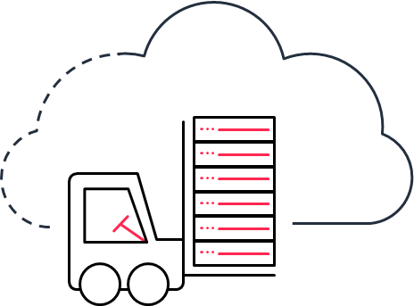







Customers are migrating their workloads to AWS
Verizon is migrating over 1,000 business-critical applications and database backend systems to AWS, several of which also include the migration of production databases to Amazon Aurora.
Trimble migrated their Oracle databases to Amazon RDS and project they will pay about 1/4th of what they paid when managing their private infrastructure.
By migrating from Microsoft SQL Server to Amazon Aurora, Ryanair can run one of the largest email campaigns in Europe with higher performance at a fraction of the cost, sending out 22 million emails daily to customers.
Samsung Electronics migrated their Cassandra clusters to Amazon DynamoDB for their Samsung Cloud workload with 70% cost savings.
Intuit migrated from Microsoft SQL Server to Amazon Redshift to reduce data-processing timelines and get insights to decision makers faster and more frequently.
Equinox Fitness migrated its Teradata on-premises data warehouse to Amazon Redshift. They went from static reports to a modern data lake that delivers dynamic reports.
Migrated their Market Data system from SQL Server to Aurora MySQL using AWS Database Migration Service(DMS) to replicate data nightly. Reduces their processing times from 8 hours to 3 hours.
© 2019, Amazon Web Services, Inc. or its affiliates. All rights reserved.

Slide 33


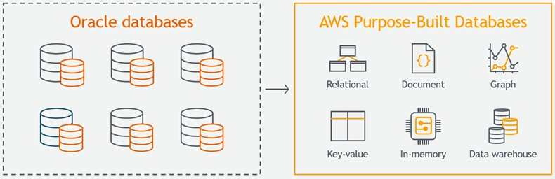
Amazon’s Consumer Business Just Turned off its Final Oracle Database
75 petabyte of internal data stored
Nearly 7,500 Oracle databases
Cost Reduction – over 60%
Performance Improvements - 40% latency improvement
Administrative Overhead - 70%
Alexa, Amazon Prime, Amazon Prime Video, Amazon Fresh, Kindle, Amazon Music, Audible, Shopbop, Twitch, and Zappos,
https://aws.amazon.com/blogs/aws/migration-complete-amazons- consumer-business-just-turned-off-its-final-oracle-database/
© 2019, Amazon Web Services, Inc. or its affiliates. All rights reserved.

Slide 34









Re-architect options
Less
More
On-Premises
Cloud
Compute
Server, VM Container, K8S
MySQL, PostgreSQL SQL Server, Oracle, MongoDB
AWS Elastic Beanstalk
Fargate
EKS
Lambda
Databases
Amazon RDS
Aurora
DocumentDB
Aurora Serverless
DynamoDB
Storage
NFS, SMB
FSx
EFS
S3
Messaging
ActiveMQ Kafka, ESB
Amazon MQ
MSK
Amazon Kinesis
SQS / SNS
Analytics
Hadoop
EMR
Amazon Elasticsearch Service
Amazon Athena
Elasticsearch Service
© 2019, Amazon Web Services, Inc. or its affiliates. All rights reserved.

Slide 35


Comparing Migration Strategies
Low
Strategy | Time | Cost | Business Value | # App
Retain |  |  | N/A | 5
Retire |  |  | N/A | 5
Relocate vmware to VMC |  |  |  | 10
Re-host any to AWS EC2 |  |  |  | 20
Re-platform LB to ALB, DB to AWS RDS |  |  |  | 30
Re-purchase SaaS |  |  |  | 5
Re-architect Cloud native |  |  |  | 30
Migration Complexity
High
© 2019, Amazon Web Serv
ices, Inc. or its affiliates. All rights reserved.

Slide 36
















Migration heatmap
Pilot
High business value
Hard to migrate
Easy to migrate
© 201L9,oAmwazonbWeub Sseirvnicees, Isncs. or vitsaaffliluiatees. All rights reserved.

Slide 37



Cost savings improve through optimizations
Typical TCO comparison
Post migration cost savings
True TCO comparison
On- Lift & Shift Premises
Instance Right-Sizing
Improved Elasticity
Measure, Monitor, Improve
Optimized Storage EC2 Optimization
Managed Services
Serverless Architecture
True AWS Optimized
© 2019, Amazon Web Services, Inc. or its affiliates. All rights reserved.

Slide 38

Break
© 2019, Amazon Web Services, Inc. or its Affiliates. All rights reserved. Amazon Confidential and Trademark
© 2019, Amazon Web Services, Inc. or its Affiliates. All rights reserved. Amazon Confidential and Trademark

Slide 39




AWS Migration Hub
Centralized Tracking
Migration Flexibility
Improved Visibility
© 2018, Amazon Web Services, Inc. or its Affiliates. All rights reserved. Amazon Confidential and Trademark

Slide 40
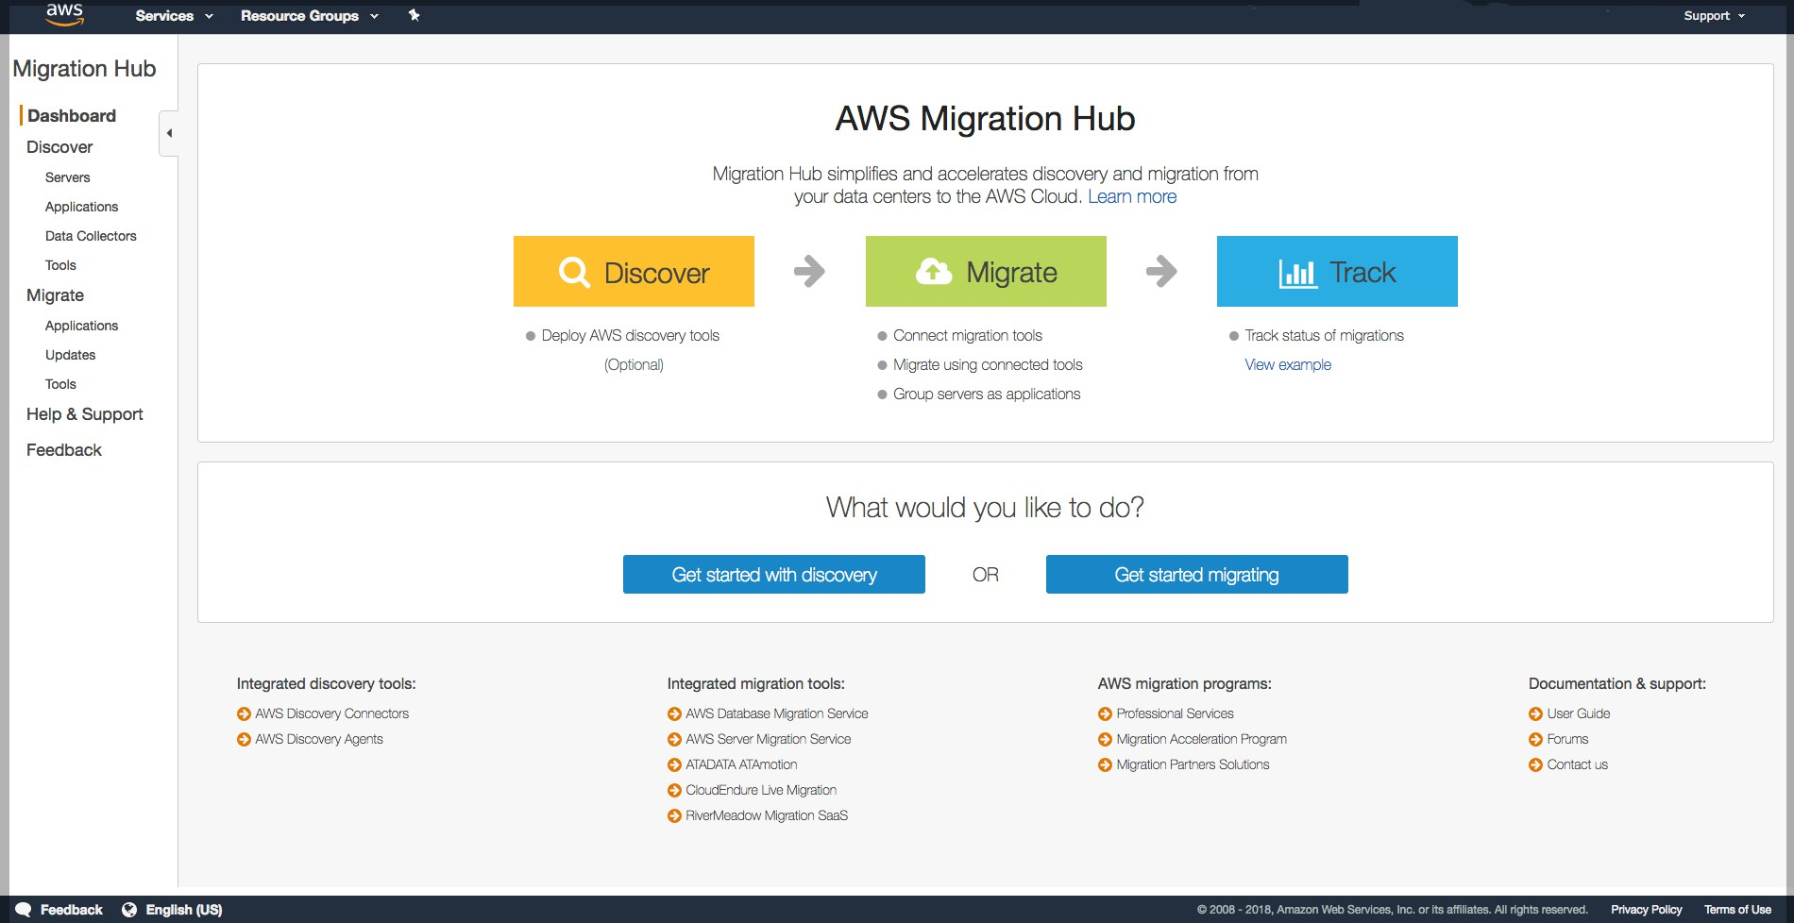
AWS Migration Hub
Migration Hub provides a single location to track the progress of application migrations across multiple AWS and partner solutions
Using Migration Hub allows you to choose the AWS and partner migration tools that best fit your needs, while providing visibility into the status of migrations across your portfolio of applications
© 2018, Amazon Web Services, Inc. or its Affiliates. All rights reserved. Amazon Confidential and Trademark

Slide 41





Integrated Migration Tools
With SMS, Import VM images from your existing environment to ready-to-use Amazon EC2 instances
AWS Server Migration Service
DMS helps you migrate databases to AWS easily and securely
AWS Database Migration Service
CloudEndure Live Migration provides automated migration to AWS from any physical or virtual infrastructure
ATAmotion auto-migrates live workloads directly to your VPC from any physical, virtual or cloud source, without installing agents.
AWS
Migration Hub
RiverMeadow Server Migration SaaS provides high performance and secure workload migrations into AWS VPC environments.
© 2018, Amazon Web Services, Inc. or its Affiliates. All rights reserved. Amazon Confidential and Trademark

Slide 42
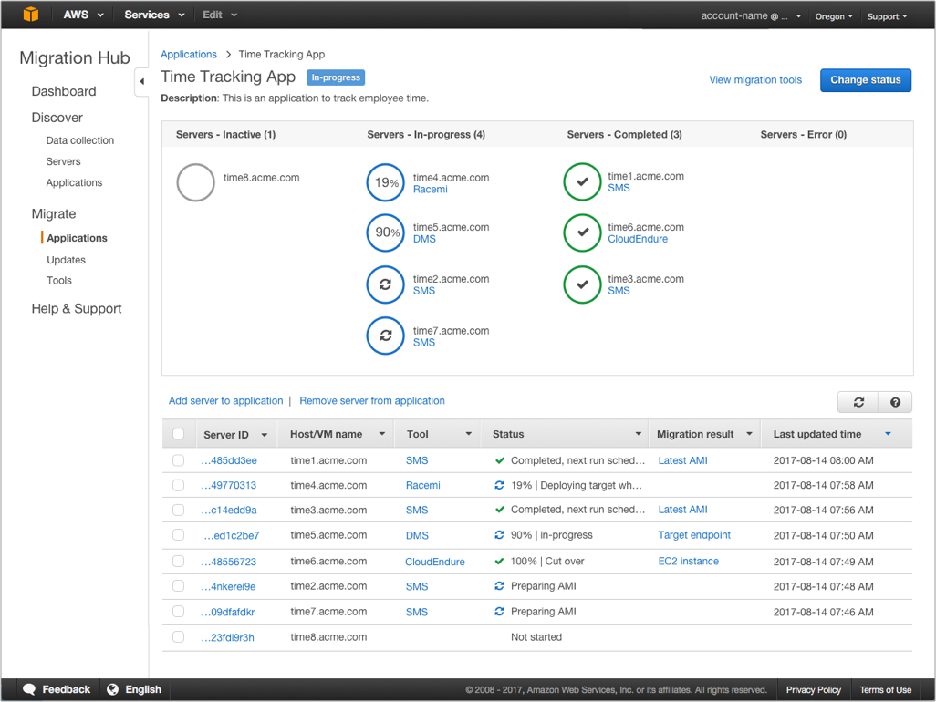
Migration Tracking
The migration tools, if authorized, automatically send status updates and results back to Migration Hub, for display on the migration status page for the application.
© 2018, Amazon Web Services, Inc. or its Affiliates. All rights reserved. Amazon Confidential and Trademark
©2017, Amazon Web Services, Inc. or its affiliates. All rights reserved

Slide 43
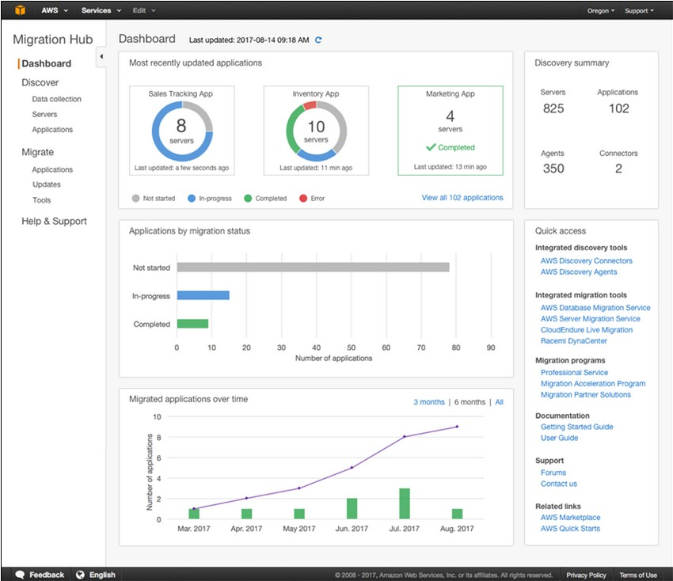
Migration Tracking
Track the status and key metrics of your application migrations by checking the Migration Hub Dashboard
© 2018, Amazon Web Services, Inc. or its Affiliates. All rights reserved. Amazon Confidential and Trademark
©2017, Amazon Web Services, Inc. or its affiliates. All rights reserved

Slide 44
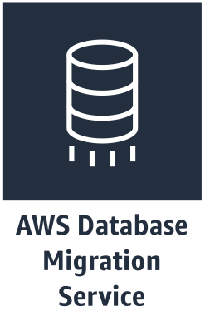
AWS Database Migration Service
Sources* | Targets*
Oracle | Oracle
SQL Server | SQL Server
Azure SQL | PostgreSQL
PostgreSQL | MySQL
MySQL | Amazon Redshift
SAP ASE | SAP ASE
MongoDB | Amazon S3
Amazon S3 | Amazon DynamoDB
IBM DB2 | Amazon Kinesis
Amazon ElasticSearch
Start your first migration in 10 minutes or less
Keep your apps running during the migration
Replicate from within, to, or from
AWS
Move data to the same or
different database engine
© 2018, Amazon Web Services, Inc. or its Affiliates. All rights reserved. Amazon Confidential and Trademark

Slide 45






Keep your application running during migration
On-Premise
AWS Cloud
Generic database
DB Instance
Start a replication instance
Connect to the source and target Select tables, schemas, or databases
Let DMS create the target objects
Move data and synchronize objects Switch applications when ready
© 2018, Amazon Web Services, Inc. or its Affiliates. All rights reserved. Amazon Confidential and Trademark

Slide 46
Database Migration Options
Load is table by table
Configurable number of tables in parallel
One time load or Change Data Capture (CDC)
Read from database log on the source and apply to the target
Filter criteria available for selective loading
Select only a few tables or a subset of data in your tables
Multiple sources and targets. Mix and match.
One side of the migration must be in AWS
Ongoing replication support
Keep your replication going until your application is ready to cutover
© 2018, Amazon Web Services, Inc. or its Affiliates. All rights reserved. Amazon Confidential and Trademark

Slide 47
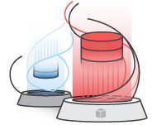
AWS Schema Conversion Tool
Makes heterogeneous database migrations predictable by automatically converting the source database schema and a majority of the database code objects, including views, stored procedures, and functions, to a format compatible with the target database
Features
Database Migration Assessment report for choosing the right target engine Automatic conversion for eligible database objects and code
Code browser to highlight places where manual edits are required
© 2018, Amazon Web Services, Inc. or its Affiliates. All rights reserved. Amazon Confidential and Trademark

Slide 48
Support for the following conversions
Source* Database | Target* Database on AWS
Oracle database | Amazon Aurora, MySQL, PostgreSQL, Oracle
Oracle data warehouse | Amazon Redshift
Azure SQL | Amazon Aurora, MySQL, PostgreSQL
Microsoft SQL Server | Amazon Aurora, Amazon Redshift, MySQL PostgreSQL
Teradata | Amazon Redshift
IBM Netezza | Amazon Redshift
Greenplum | Amazon Redshift
HPE Vertica | Amazon Redshift
MySQL and Maria DB | PostgreSQL
PostgreSQL | Amazon Aurora, MySQL
Amazon Aurora | PostgreSQL
IBM DB2 LUW | Amazon Aurora, MySQL, PostgreSQL
Apache Cassandra | Amazon DynamoDB
© 2018, Amazon Web Services, Inc. or its Affiliates. All rights reserved. Amazon Confidential and Trademark

Slide 49
CloudEndure
© 2019, Amazon Web Services, Inc. or its Affiliates. All rights reserved. Amazon Confidential and Trademark
© 2019, Amazon Web Services, Inc. or its Affiliates. All rights reserved. Amazon Confidential and Trademark

Slide 50






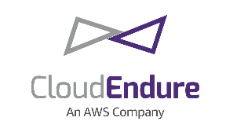

Simplify and Accelerate Migration With CloudEndure
Flexible
Reliable
Highly Automated
Designed for rapid, large-scale migrations
Simple setup lets you start in minutes
Robust, Predictable, Non-Disruptive Continuous Replication
Short Cutover Windows With Minimal Downtime
Highly Secure for Regulated Environments
Minimal Skill Set Required to Operate
Easy, Non- Disruptive Tests Prior to Cutover
Easily Plugs Into Migration Factories and Cloud COEs
Migrate From Any Source
Same highly automated process for any workload
Common workloads include databases such as Microsoft SQL Server, Oracle, and MySQL, and enterprise applications such as SAP
Wide Range of OS, Application, and Database Support
Eliminates complexity and reduces risk
Migrate with minimal business disruption
Option to Migrate Back
© 2019, Amazon Web Services, Inc. or its Affiliates. All rights reserved. Amazon Confidential

Slide 51
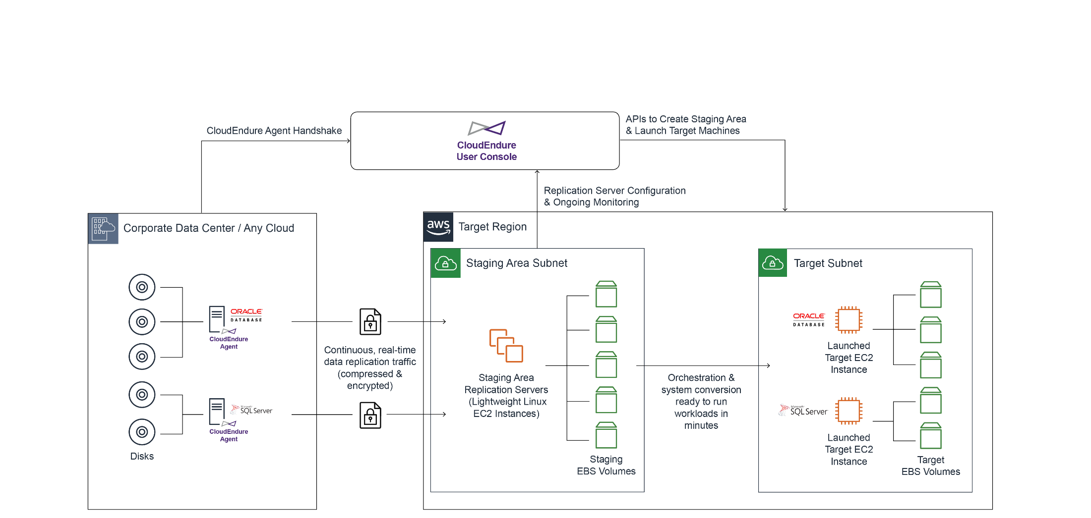
How CloudEndure Migration Works
CloudEndure continuously replicates any application or database from any source into AWS
Business outcome: Allow self-service, rapid, reliable migrations with minimal business disruption
© 2019, Amazon Web Services, Inc. or its Affiliates. All rights reserved. Amazon Confidential

Slide 52






















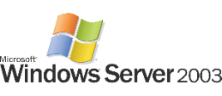














Wide Platform Support*
Any Application
Any Database
x86 Operating Systems
Windows Workstations
Source Infrastructure
Physical Data Centers
* See documentation or contact Support for a complete list.
© 2019, Amazon Web Services, Inc. or its Affiliates. All rights reserved. Amazon Confidential

Slide 53




CloudEndure Migration Success Stories
After deploying CloudEndure Disaster Recovery, Malibu Boats experienced an outage
Failover to AWS in recovery mode resulted in 2x faster performance in the cloud
Led to a business decision to significantly expedite migration to AWS
Complete self-service migration as part of MAP program; finished on schedule
Legacy applications running on ~1,000 Windows servers of various versions
Automated lift-and-shift with no performance disruption
100% success in migrating all workloads
Continuous replication of large servers, filers, and Oracle-based legacy applications
Cutover was complete within minutes with no system disruption
End users were unaware of the migration, and business continued as usual
Accelerated migration of ~3,000 servers with COTS applications
Multiple sources (mix of virtual and physical, different OS types and versions)
Significant cost savings by retiring legacy infrastructure
ProServe provided cloud skills training
© 2019, Amazon Web Services, Inc. or its Affiliates. All rights reserved. Amazon Confidential

Slide 54


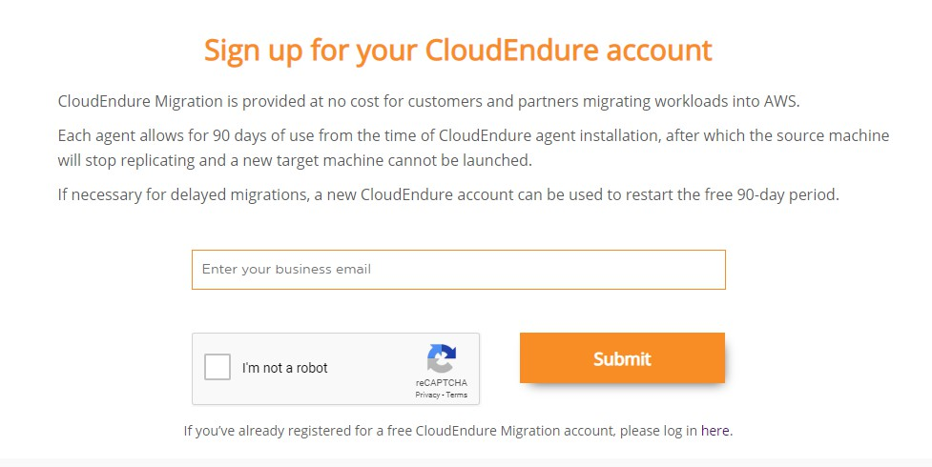
CloudEndure Migration License Model
Get started with
free migration licenses
Each license – one per source machine – is valid for 90 days
For assistance, contact your consulting partner, account team, or AWS Professional Services
Additional program benefits available to qualified customers and partners
© 2019, Amazon Web Services, Inc. or its Affiliates. All rights reserved. Amazon Confidential

Slide 55


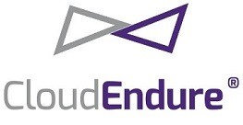












On-premise / Colocation
AWS Cloud
DC1
Availability Zone 1
VPC
LB
LB
LB
LB
Web
Web
Web
Web
Continuous, real-time data
replication traffic
App
App
App
App
free license allows for 90 days
DB
DB
DB
DB
NFS/SMB
NFS/SMB
NFS/SMB NFS/SMB
© 2019, Amazon Web Services, Inc. or its affiliates. All rights reserved.

Slide 56
CloudEndure Lab
© 2019, Amazon Web Services, Inc. or its Affiliates. All rights reserved. Amazon Confidential and Trademark

Slide 57
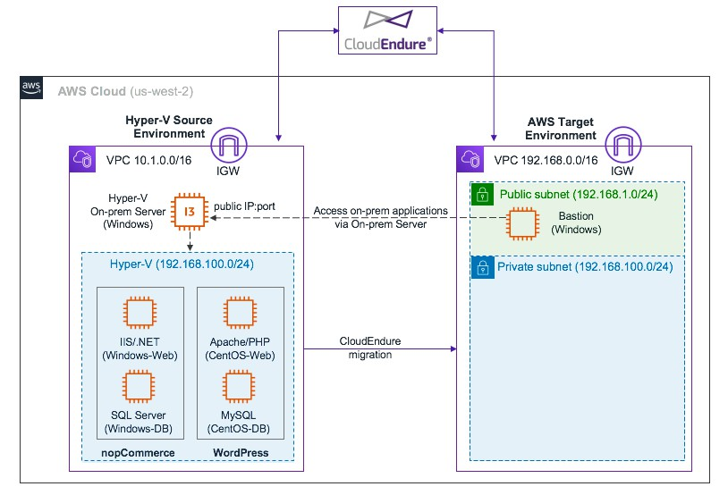
© 2019, Amazon Web Services, Inc. or its Affiliates. All rights reserved. Amazon Confidential and Trademark
© 2019, Amazon Web Services, Inc. or its Affiliates. All rights reserved. Amazon Confidential and Trademark

Slide 58
https://dashboard.eventengine.run
© 2019, Amazon Web Services, Inc. or its Affiliates. All rights reserved. Amazon Confidential and Trademark
© 2019, Amazon Web Services, Inc. or its Affiliates. All rights reserved. Amazon Confidential and Trademark

Slide 59
Summary
7R
Modernize through
Re-host
Re-platform
Re-architect
Migration strategies and heatmap AWS SMS
Migrate Experiment!
© 2019, Amazon Web Services, Inc. or its Affiliates. All rights reserved. Amazon Confidential and Trademark

Slide 60


Thank you!
Fill in the survey and receive
$25 USD AWS Credit!
© 2018, Amazon Web Services, Inc. or its Affiliates. All rights reserved. Amazon Confidential and Trademark
© 2019, Amazon Web Services, Inc. or its Affiliates. All rights reserved. Amazon Confidential and Trademark

